Slide 1
NIELIT SUMMER INTERN 2021
COURSE:
Machine learning using Python (6 months internship)
NAME:
Vinay Kadel
PROJECT NAME:
Wine quality analysis and prediction

Slide 2
CODE EDITOR AND LANGUAGES USED :
Spyder (SOURCE CODE EDITOR)
Python

Slide 3
FEATURES and Algorithm used:
It has many features like:-
Plot and graphs
Data decision
Random forest classifier

Slide 4
DESCRIPTION:
Here we will predict the quality of wine on the basis of giving features. We use the wine quality dataset from Kaggle. This dataset has the fundamental features which are responsible for affecting the quality of the wine. By the use of several Machine learning models, we will predict the quality of the wine. Here we will only deal with the white type wine quality, we use classification techniques to check further the quality of the wine i.e. is it good or bed.

Slide 5
Dataset description:
In this dataset, classes are ordered, but it was not balanced. Here, red wine instances are present at a high rate and white wine instances are less than red.
Data set Link
https://www.kaggle.com/uciml/red-wine-quality-cortez-et-al-2009

Slide 6
Type
fixed acidity
volatile acidity
citric acid
residual sugar
chlorides
free sulfur dioxide
total sulfur dioxide
density
pH
sulphates
alcohol
quality

Slide 7
Process and code –
Importing the Dependencies
"""
import numpy as np
import pandas as pd
import matplotlib.pyplot as plt
import seaborn as sns
from sklearn.model_selection import train_test_split
from sklearn.ensemble import RandomForestClassifier
from sklearn.metrics import accuracy_score

Slide 8
"""Data Collection"""
# loading the dataset to a Pandas DataFrame
wine_dataset = pd.read_csv(R'E:\Learning\winequality-red.csv')
# number of rows & columns in the dataset
wine_dataset.shape
# first 5 rows of the dataset
wine_dataset.head()
# checking for missing values
wine_dataset.isnull().sum()

Slide 9
"""Data Analysis and Visualization"""
"""Data Analysis and Visualization"""
# statistical measures of the dataset
wine_dataset.describe()
# number of values for each quality
sns.catplot(x='quality', data = wine_dataset, kind = 'count')
# volatile acidity vs Quality
plot = plt.figure(figsize=(5,5))
sns.barplot(x='quality', y = 'volatile acidity', data = wine_dataset)
# citric acid vs Quality
plot = plt.figure(figsize=(5,5))
sns.barplot(x='quality', y = 'citric acid', data = wine_dataset)

Slide 10
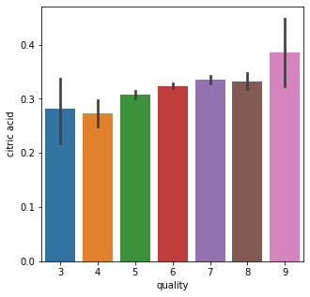
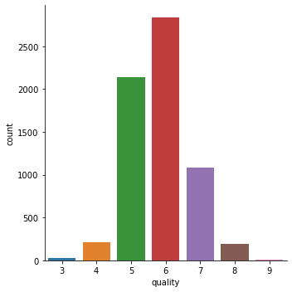

Slide 12
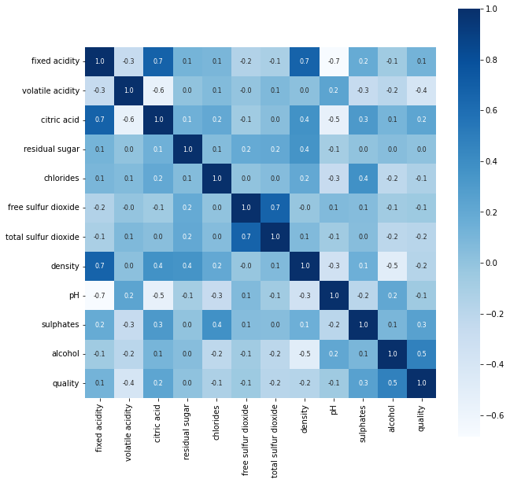
MENU PAGE:

Slide 13
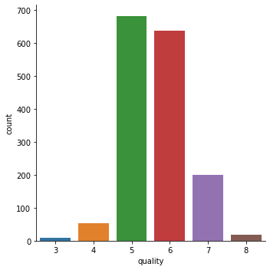
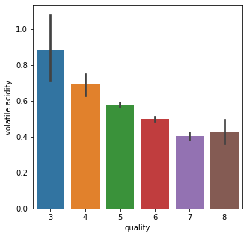
SINGLE CATEGORIES: (after clicking menu category )

Slide 14
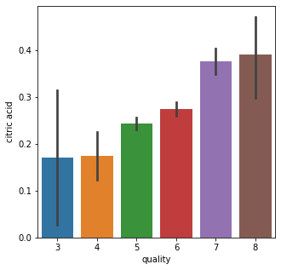

Slide 15
"""Correlation
1. Positive Correlation
2. Negative Correlation
"""
correlation = wine_dataset.corr()
# constructing a heatmap to understand the correlation between the columns
plt.figure(figsize=(10,10))
sns.heatmap(correlation, cbar=True, square=True, fmt = '.1f', annot = True, annot_kws={'size':8}, cmap = 'Blues'

Slide 16
"""Data Preprocessing"""
# separate the data and Label
X = wine_dataset.drop('quality',axis=1)
print(X)
"""Label Binarizaton"""
Y = wine_dataset['quality'].apply(lambda y_value: 1 if y_value>=7 else 0)
print(Y)

Slide 17
"""Train & Test Split"""
X_train, X_test, Y_train, Y_test = train_test_split(X, Y, test_size=0.2, random_state=3)
print(Y.shape, Y_train.shape, Y_test.shape)
"""Model Training:
Random Forest Classifier
"""
model = RandomForestClassifier()
model.fit(X_train, Y_train)

Slide 18
"""Model Evaluation
Accuracy Score
"""
# accuracy on test data
X_test_prediction = model.predict(X_test)
test_data_accuracy = accuracy_score(X_test_prediction, Y_test)
print('Accuracy : ', test_data_accuracy)
input_data = (7.5,0.5,0.36,6.1,0.071,17.0,102.0,0.9978,3.35,0.8,10.5)

Slide 19
# changing the input data to a numpy array
input_data_as_numpy_array = np.asarray(input_data)
# reshape the data as we are predicting the label for only one instance
input_data_reshaped = input_data_as_numpy_array.reshape(1,-1)
prediction = model.predict(input_data_reshaped)
print(prediction)
if (prediction[0]==1):
print('Good Quality Wine')
else:
print('Bad Quality Wine')

Slide 20
runfile('C:/Users/vinay kadel/Downloads/project_wine_quality_prediction vinay.py', wdir='C:/Users/vinay kadel/Downloads’)
fixed acidity volatile acidity citric acid ... pH sulphates alcohol
0 7.4 0.700 0.00 ... 3.51 0.56 9.4
1 7.8 0.880 0.00 ... 3.20 0.68 9.8
2 7.8 0.760 0.04 ... 3.26 0.65 9.8
3 11.2 0.280 0.56 ... 3.16 0.58 9.8
4 7.4 0.700 0.00 ... 3.51 0.56 9.4
... ... ... ... ... ... ...
1594 6.2 0.600 0.08 ... 3.45 0.58 10.5
1595 5.9 0.550 0.10 ... 3.52 0.76 11.2
1596 6.3 0.510 0.13 ... 3.42 0.75 11.0
1597 5.9 0.645 0.12 ... 3.57 0.71 10.2
1598 6.0 0.310 0.47 ... 3.39 0.66 11.0

Slide 21
1599 rows x 11 columns]
0 0
1 0
2 0
3 0
4 0
..
1594 0
1595 0
1596 0
1597 0
1598 0
Name: quality, Length: 1599, dtype: int64
(1599,) (1279,) (320,)
Accuracy : 0.9375
[0]
Bad Quality Wine

Slide 22
THANK YOU !

